Slide 1
CSE326
INTERNET PROGRAMMING LABORATORY
Lecture #0
The kick start session

Slide 2
Course Details
Course Code:- CSE326
LTP:- 0 0 3 [0 lectures, 3 practical's /week]
Credits:- 2

Slide 3
Vision
To be a globally recognized school through excellence in teaching, learning and research for creating Computer Science professionals, leaders and entrepreneurs of future contributing to society and industry for sustainable growth.

Slide 4
Mission
To build computational skills through hands-on and practice-based learning with measurable outcomes.
To establish a strong connect with industry for in-demand technology driven curriculum.
To build the infrastructure for meaningful research around societal problems.
To nurture future leaders through research-infused education and lifelong learning.
To create smart and ethical professionals and entrepreneurs who are recognized globally

Slide 5
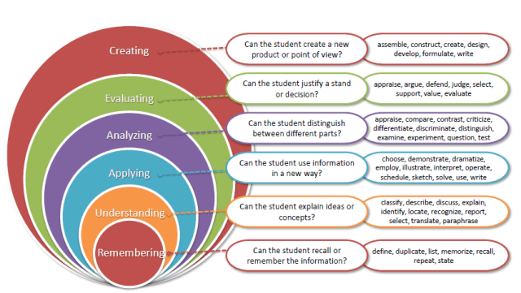
Revised Bloom’s Taxonomy

Slide 6
Course outcome
Through this course students should be able to:
CO1 :: identify HTML document structure, work with basic elements, and utilize different types of tags to create well-structured web pages.
CO2 :: apply text, create links, embed multimedia, and work with images to enhance the visual and interactive aspects of web pages.
CO3 :: cultivate CSS selectors, properties, and the box model on different HTML elements to effectively construct a web page
CO4 :: construct and style tables, implement form controls, and apply CSS to enhance the layout and functionality of web forms

Slide 7
Course outcome(cont.)
CO5 :: develop interactive web applications by incorporating JavaScript code for variable manipulation, control statements, looping, popup boxes, object manipulation, and form validation.
CO6 :: manipulate and interact with web page elements dynamically using JavaScript DOM methods and properties.

Slide 8
Program Outcomes
PO1 Engineering knowledge: Apply the knowledge of mathematics, science, engineering fundamentals, and an engineering specialization to the solution of complex engineering problems.
PO2 Problem analysis::Identify, formulate, research literature, and analyze complex engineering problems reaching substantiated conclusions using first principles of mathematics, natural sciences, and engineering sciences.
PO3 Design/development of solutions::Design solutions for complex engineering problems and design system components or processes that meet the specified needs with appropriate consideration for the public health and safety, and the cultural, societal, and environmental considerations.
PO4 Conduct investigations of complex problems::Use research-based knowledge and research methods including design of experiments, analysis and interpretation of data, and synthesis of the information to provide valid conclusions.

Slide 9
Program Outcomes
PO5 Modern tool usage::Create, select, and apply appropriate techniques, resources, and modern engineering and IT tools including prediction and modeling to complex engineering activities with an understanding of the limitations.
PO6 The engineer and society::Apply reasoning informed by the contextual knowledge to assess societal, health, safety, legal and cultural issues and the consequent responsibilities relevant to the professional engineering practice.
PO7 Environment and sustainability::Understand the impact of the professional engineering solutions in societal and environmental contexts, and demonstrate the knowledge of, and need for sustainable development.
PO8 Ethics::Apply ethical principles and commit to professional ethics and responsibilities and norms of the engineering practice.
PO9 Individual and team work::Function effectively as an individual, and as a member or leader in diverse teams, and in multidisciplinary settings.

Slide 10
Program Outcomes
PO10 Communication::Communicate effectively on complex engineering activities with the engineering community and with society at large, such as, being able to comprehend and write effective reports and design documentation, make effective presentations, and give and receive clear instructions.
PO11 Project management and finance::Demonstrate knowledge and understanding of the engineering, management principles and apply the same to one’s own work, as a member or a leader in a team, manage projects efficiently in respective disciplines and multidisciplinary environments after consideration of economic and financial factors.
PO12 Life-long learning::Recognize the need for, and have the preparation and ability to engage in independent and life-long learning in the broadest context of technological change.

Slide 11
Course contents
Unit I
Exposure To HTML : HTML document structure, Working with HTML basic elements like title, head, body, Working with Root and Metadata, Horizontal Rules and line breaks and paragraph, working with citation, quotation, definitions and comments, Types of Tags in HTML

Slide 12
Course contents
Unit II
Working with Text, Links, Images and Tables in HTML : Formatting text with HTML physical style elements, Formatting text with HTML logical style elements, Arranging text, Exploring the Hyperlinks and linking to a mail system, Exploring the link relations, Working with images in a web page, Displaying Plain, Bold, Italic, Small, Subscripted, Superscripted text, Displaying Program Code, Program Output, Keyboard text, Emphasizing text, Defining New Terms, Short and long Quotations, Creating Links with anchor tag.

Slide 13
Course contents
Unit III
Introduction to Cascading Style Sheets : CSS rules like link and style, CSS properties like text controlling and text formatting, CSS selectors like type, id, class, Introduction To CSS and types of CSS, Inline CSS, Internal CSS, External CSS, CSS Box Model- Padding, Margin, Border, Div and Span Tag in CSS, Working with background Images.

Slide 14
Course contents
Unit IV
Working with Tables : Working With Tables-Colspan and Rowspan, applying css on tables, creating hoverable tables
Working with Forms : Working with Forms- action attribute, get and post methods, Form Elements and Controls Like Text Inputs, TextArea, Buttons, CheckBoxes, Dropdown Boxes, Radio Buttons,
Select and File Select, applying css on all controls of forms
CSS Grids and Webpage Layouts : Grid introduction, Grid container, Grid Item, Creating different layouts for webpage

Slide 15
Course contents
Unit V
JavaScript Application Development : Incorporating JavaScript in the HEAD and BODY element, Using an External JavaScript file, Using variables and operators, Using control statements such as if...else, switch, break and continue, Using looping statements such as while, do...while, for, Using Popup boxes such as Alert, Confirm, and Prompt, Working with JavaScript Objects,Properties and Methods.
JavaScript Functions,Events and Validation : Working with Functions-Using function arguments and return statement, Working with JavaScript Events like Form Based, Keyboard Based and Mouse Based, JavaScript Form Validation.

Slide 16
Course contents
Unit VI
Javascript DOM : DOM introduction, DOM methods, DOM document, DOM elements, DOM HTML, DOM CSS, DOM Events

Slide 17
Complete evaluation criteria for the course
CA1: 30 marks (Visual Implementation Assessment -VIA)
HTML Skill Assessment: Understanding of HTML structure and syntax, knowledge of common HTML tags, proficiency in using links , knowledge of elements and attributes.
CA2: 30 marks (Visual Implementation Assessment –VIA)
CSS Skills Assessment: Understanding of CSS syntax, selectors (e.g., class, id, element), box model (margin, padding, border), positioning (static, relative, absolute), responsive design principles (media queries), CSS3 features (animations, transitions, flexbox, grid).
CA3: 30 marks (Project)
Project in HTML, CSS, JS Skills Assessment: Proficiency in creating HTML structure, applying CSS styling, and implementing JavaScript for interactive web projects.

Slide 18
CA 3 – Project Rubrics
Functionality and Deployment(6),
User Interface(6),
Novelty/Uniqueness(6),
Documentation(6),
Presentation(6),

Slide 19
Why Star Course?
Industry Demand:
High: Essential for front-end web development roles across industries.
Skills Needed: Proficiency in creating and styling web pages using HTML5, CSS3, and JavaScript for interactive features.
Product-Based Companies:
Skills Sought: Ability to create responsive and visually appealing web applications that enhance user experience.
Service-Based Companies:
Demand: Significant, especially in client-facing projects and website development services.
Government Jobs:
Relevance: Increasingly important in digital government initiatives and web-based services.

Slide 20
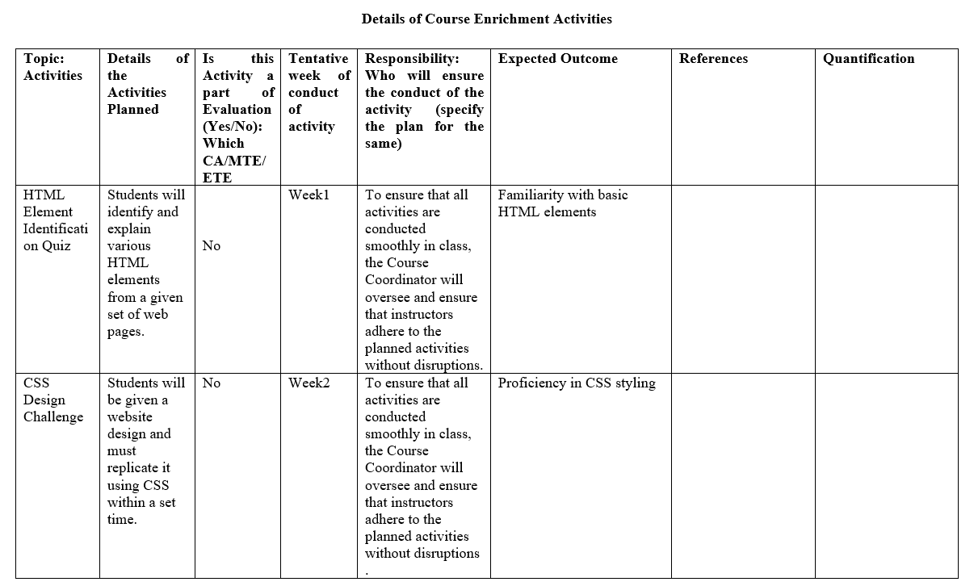
Execution Strategies

Slide 21
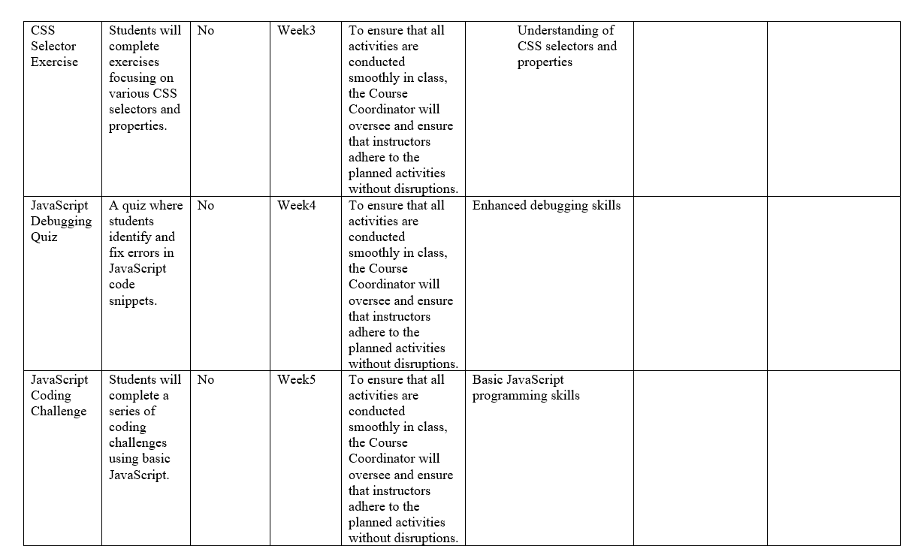
Execution Strategies

Slide 22
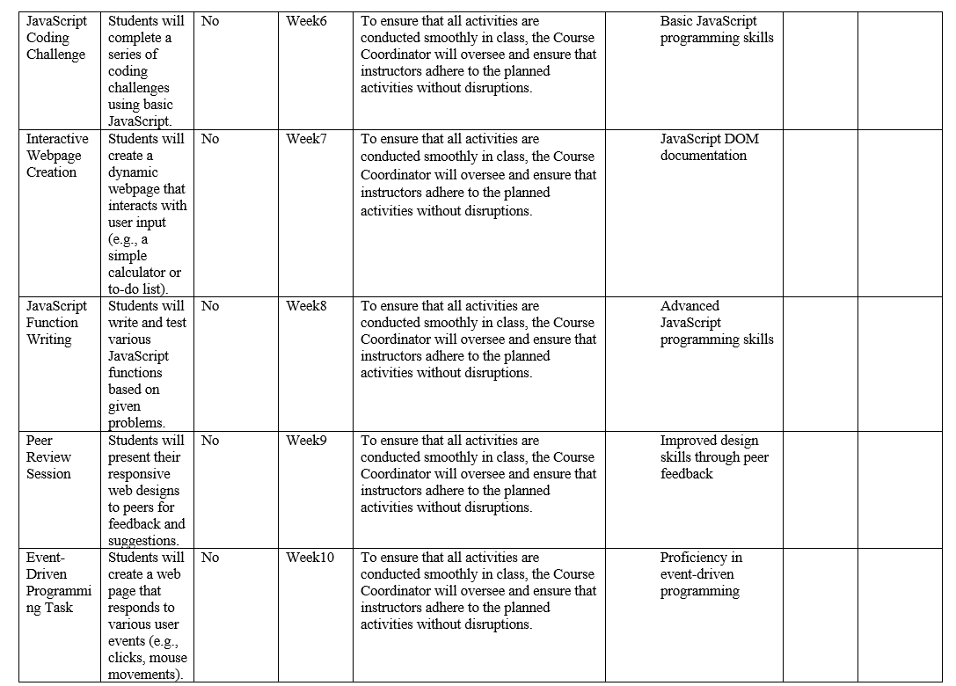
Execution Strategies

Slide 23
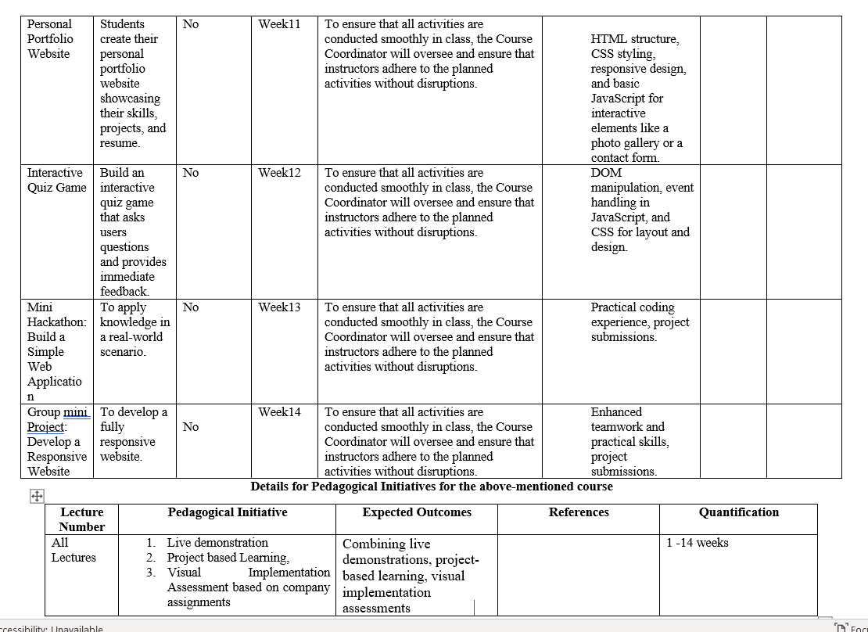
Execution Strategies

Slide 24
Open Education Resources(OER)
Unit mapped | Broad topic | Source Type | Source Title | *%age mapping (approx) | Source URL
Unit 1 | Exposure To HTML | Reading Material | INTERNET PROGRAMMING LABORATORY | 100% | https://www.w3schools.com/html/html_head.asp
Unit 2 | Working with Text, Links, Images and Tables in HTML | Reading Material | INTERNET PROGRAMMING LABORATORY | 100% | https://www.w3schools.com/html/html_formatting.asp
Unit 3 | Cascading Style Sheets | Reading Material | INTERNET PROGRAMMING LABORATORY | 100% | https://www.w3schools.com/html/html_css.asp
Unit 4 | Working with Tables Working with forms, CSS Grids and Webpage Layouts | Reading Material | INTERNET PROGRAMMING LABORATORY | 100% | https://www.w3schools.com/html/html_table_colspan_rowspan.asp
Unit 5 | JavaScript Application Development , JavaScript Functions,Events and Validation | Reading Material | INTERNET PROGRAMMING LABORATORY | 100% | https://www.w3schools.com/jsref/jsref_if.asp https://www.w3schools.com/js/js_events.asp
Unit 6 | Javascript DOM | Reading Material | INTERNET PROGRAMMING LABORATORY | 100% | https://www.w3schools.com/js/js_htmldom.asp

Slide 25
Skill Attainment
Technical Skills:
HTML
CSS
JS
Soft Skills:
Creativity, Time management, Adaptability.
Problem-solving, Continuous Learning.

Slide 26
Text & Reference Books
Text Books:
MASTERING HTML, CSS & JAVA SCRIPT WEB PUBLISHING by LAURA LE MAY, RAFE COLBURN, JENNIFER KYRNIN, BPB PUBLICATIONS
References:
HTML 5 BLACK BOOK by DT EDITORIAL SERVICES, DREAMTECH PRESS.

Slide 27
Softwares
Standard Editor- VS-Code.
Online Editors for Practice:
CodeSandBox
CodePen.

Slide 28
Tech Update : Most Popular Programming Languages in 2023(Stack Overflow Survey)
The Stack Overflow Developer Survey 2023 collects data from developers worldwide to understand their experiences, preferences, and challenges. It covers a wide range of topics, including the most popular programming languages, development environments, salary insights, and education levels.
Link to Read: https://survey.stackoverflow.co/2023/
Key takeaways:
JavaScript: Essential for modern web development.
HTML/CSS: Crucial for beginners and web developers.
Python: Versatile and beginner-friendly, ideal for various applications including data science and web development.
SQL: Important for database management, highly used by professionals.
TypeScript: Growing in popularity, particularly for larger web projects.
Understanding these trends can help you choose the right languages to learn, enhancing your skills and employability in the tech industry

Slide 29
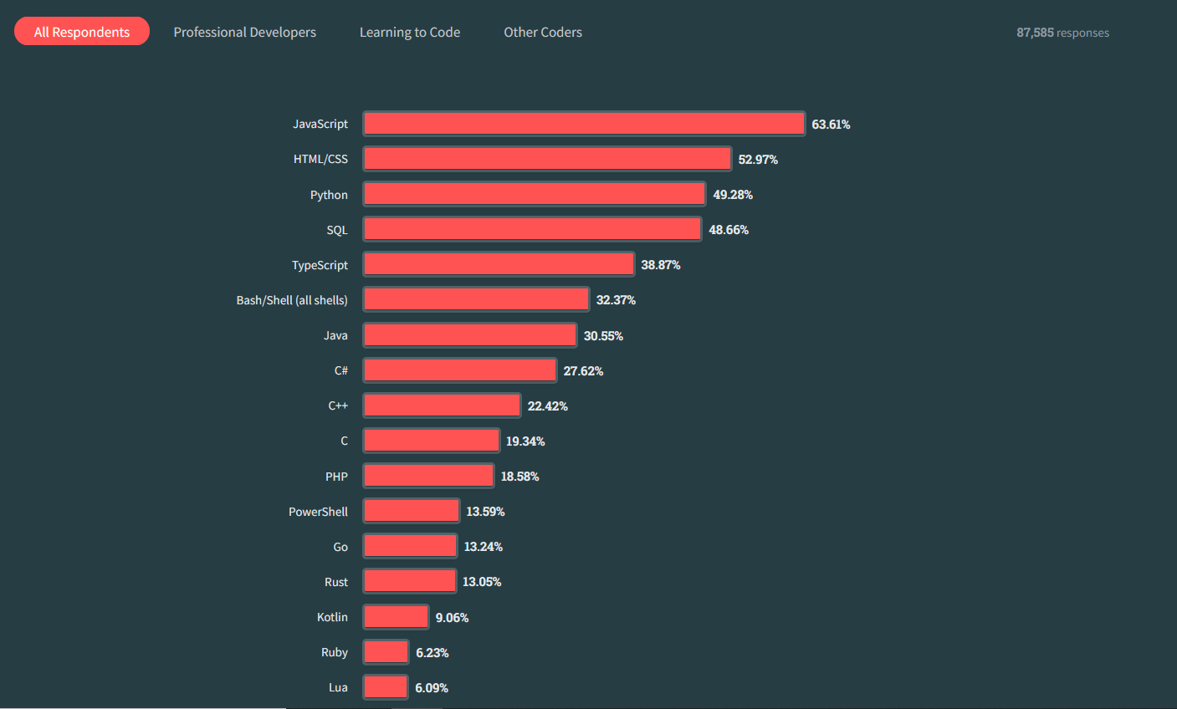
Tech Update : Most Popular Programming Languages in 2023
Key Points from the Stack Overflow Developer Survey 2023:
JavaScript: Most used programming language for 11 years (63.61% usage).
Python: Third most-used overall; top choice for beginners.
HTML/CSS: Along with JavaScript, very popular among new coders.
SQL: More frequently used by professionals than beginners.
Trends: Professionals use SQL more (52% vs. 45%), students prefer Python (59% vs. 37%).

Slide 30
Next Class: Introduction HTML

